Slide 1
Course 3 Capstone
Data Collection

Slide 2
Finding the Middle
Mean, Median, and Mode help you compare data. Below, list the mean, median, and mode of the clicks in the provided data.
Mean: 60.3856
Median: 60
Mode: 78

Slide 3
Finding the Middle
Mean, Median, and Mode help you compare data. Below, list the mean, median, and mode of the conversions in the provided data.
Mean: 5.98
Median: 6
Mode: 5

Slide 4
Standard Deviation
Determining variance in data helps you [to find how the data is spread in a datasheet]. Below, enter the standard deviation of the provided data.
Standard Deviation of Clicks: 14.37
Standard Deviation of Conversions: 1.63

Slide 5
Frequency and Contingency Tables

Slide 6
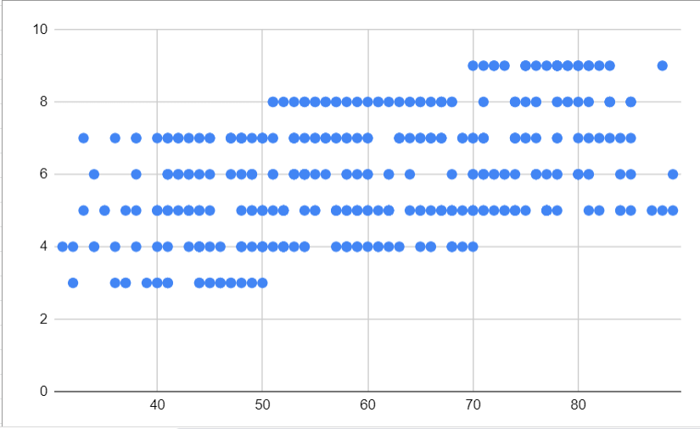
Scatter Plot
Understanding the relationships between data is important to understanding trends and patterns. Create and insert a scatter plot generated from your data. Then, include the input the correlation coefficient as well.
Scatter Plot of your data:
Correlation coefficient: 0.447993

Slide 7
End of Section 1

Slide 8
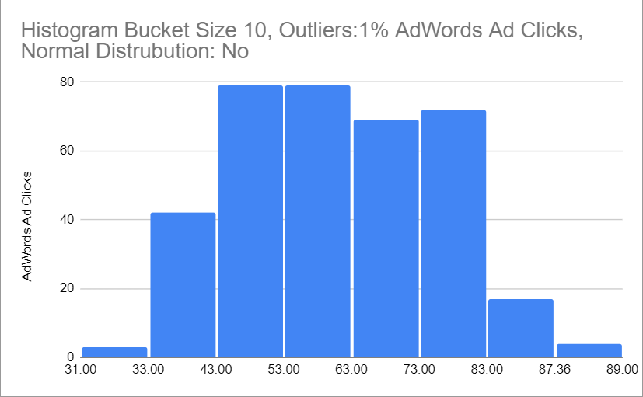
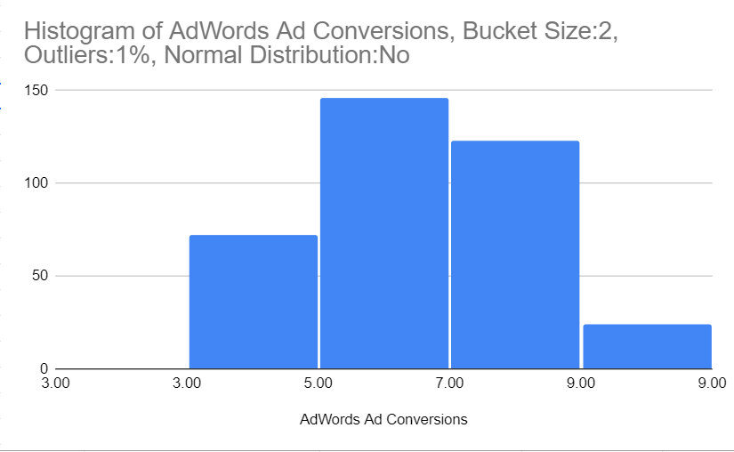
Sample Type
Histogram of your clicks data:
Histogram of conversions data:

Slide 9
Sample Type
Does the clicks data have a normal distribution? No
Does the conversions data have a normal distribution? No

Slide 10
Variable Types
Quantitative:
Continuous: AdWords Click-Through Rate, AdWords Conversion Rate, AdWords Cost per Click
Discrete: AdWords Ad Views, AdWords Ad Clicks, AdWords Ad Conversions,Cost Per Ad Words Ad,

Slide 11
End of Section 2

Slide 12
Question and Hypothesis
The question you hope to answer and your hypothesized answer are necessary to complete an analysis. Answer the following questions
What is your hypothesis based off the evaluation question?
If the business utilizes Facebook Ads instead of AdWords, it will get more conversions.

Slide 13
Question and Hypothesis
The question you hope to answer and your hypothesized answer are necessary to complete an analysis. Answer the following questions
What is your independent variable? Facebook Ad Conversions
What is your dependent variable? AdWords Ad Conversions

Slide 14
Running a Test
With your question and hypothesis ready, run the test on the two sets of data. Fill in the information below.
Mean number of Facebook conversions: 11.74
Mean number of Adware conversions: 5.96
p-Value: 0

Slide 15
Hypothesis
After running the test, was your hypothesis proven correct?
Do your findings support a null or an alternative hypothesis? xx
What’s your conclusion about your main hypothesis? Is there a difference, and is it what your hypothesis predicted?
Because my P-Value is under 0.05 there is a Significant difference, my Hypothesis predicted that there will be a difference if we advertise on Facebook instead of Google Ads.
H0 accepteed
H1 rejected

Slide 16
End of Section 3

Slide 17
Determining a Model
Based off what you know so far, you’ll need to determine if your data meets the assumptions for a chosen model. Including:
Which model makes the most sense to use and why?
I believe a good model will be the Simple Linear Regression Model because I have both quantitative values for my Dependent and Independent variables. Also I want to use a prediction for my Dependent variable based on my Independend variable.

Slide 18
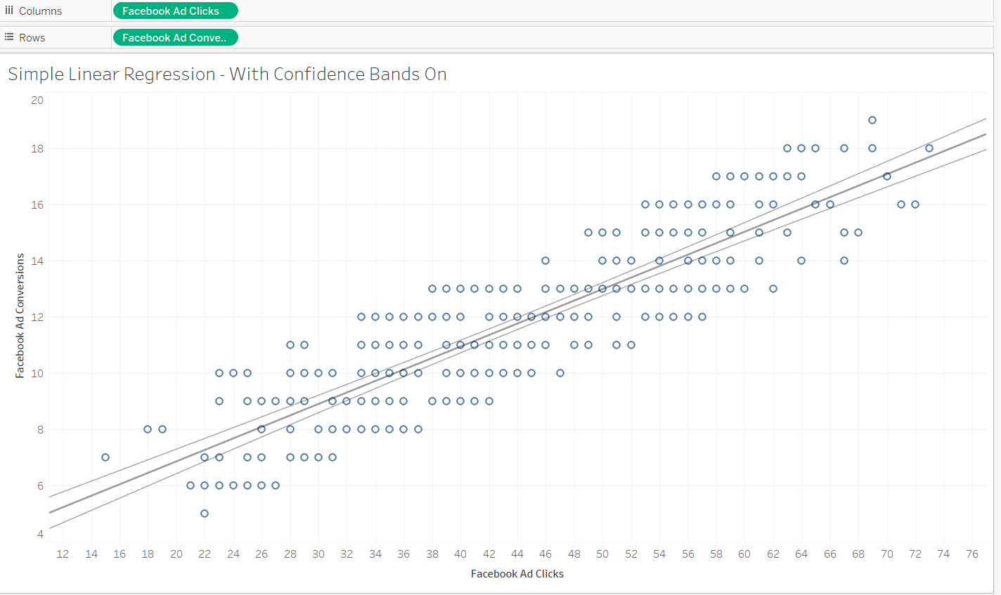
Modeling

Slide 19
End of Section 4

Slide 20
Final Insights
Now, knowing what you do about the results of your test, what are the final insights that you would share with your client? What did you learn and what would you recommend? Is there anything you would do differently next time?
Enter your insights here:
First and foremost, I would urge my customer to boost their Facebook ad spend because they have a higher conversion rate. Furthermore, I would advise him to examine the AdWords Advertising to determine why they react to this behavior and to utilize A/B testing to test other ads in order to boost the conversion rate.

